Slide 1

INFO 6150 PROJECT
TRACKIFY – THE EXPENSE TRACKER
PRATHAMESH SAHASRABUDDHE
ROHIT CHOUHAN
SUSAN TUBOKU-METZGER
VIVEK SHARMA

Slide 2
PURPOSE
Trackify helps you to log your expenses and get more detailed report through graphic visualizations.
To hold yourself accountable, improves your financial security and reduces financial stress.
Reducing financial spending & avoiding debt.
Replacing orthodox pen and paper approach of recording expense with the web application.

Slide 3
FEATURES IMPLEMENTED IN TRACKIFY
Used mongoose for connecting MongoDB.
Bcrypt, a library to help you hash password, created algorithm for password authentication.
Created REST API for Expenses and Users, fetching the expenses of individual user.
Created algorithms for converting data to display on various graphs i.e Pie Chart, Bar Chart and Line Graph.
User can put filter and sort their data and track their expenses with the data visualization graph.

Slide 4
LIBRARIES USED
Bcrypt – The password encrypt library for password hashing
amCharts v4 – The data visualization library for data representation in form of charts.
Used MaterialUI & Bootstrap for styling.
Axios - JavaScript library used to make HTTP requests.

Slide 5
CONTRIBUTIONS
PRATHAMESH SAHASRABUDDHE – User Auth, MongoDB, Filter & Sort functions, Bootstrap & MaterialUI
ROHIT CHOUHAN – REST API, MongoDB, Bootstrap & MaterialUI
SUSAN TUBOKU-METZGER -
VIVEK SHARMA - amCharts graphs and related algorithms, REST API, Bootstrap, MaterialUI
THREE OF US HAVE CONTRIBUTED IN IMPLEMENTING REACT COMPONENTS, PAGES, CONTROLLERS, ROUTES AND REST NOT MENTIONED HERE.

Slide 6
REFERENCES
https://www.amcharts.com/docs/v4/
https://mui.com/getting-started/usage/
https://v5.reactrouter.com/web/guides/quick-start
https://react-bootstrap.github.io/layout/grid/
https://www.npmjs.com/package/react-axios
https://developer.mozilla.org/en-US/docs/Web/JavaScript
https://developer.mozilla.org/en-US/docs/Web/Web_Components

Slide 7


Slide 8


Slide 9
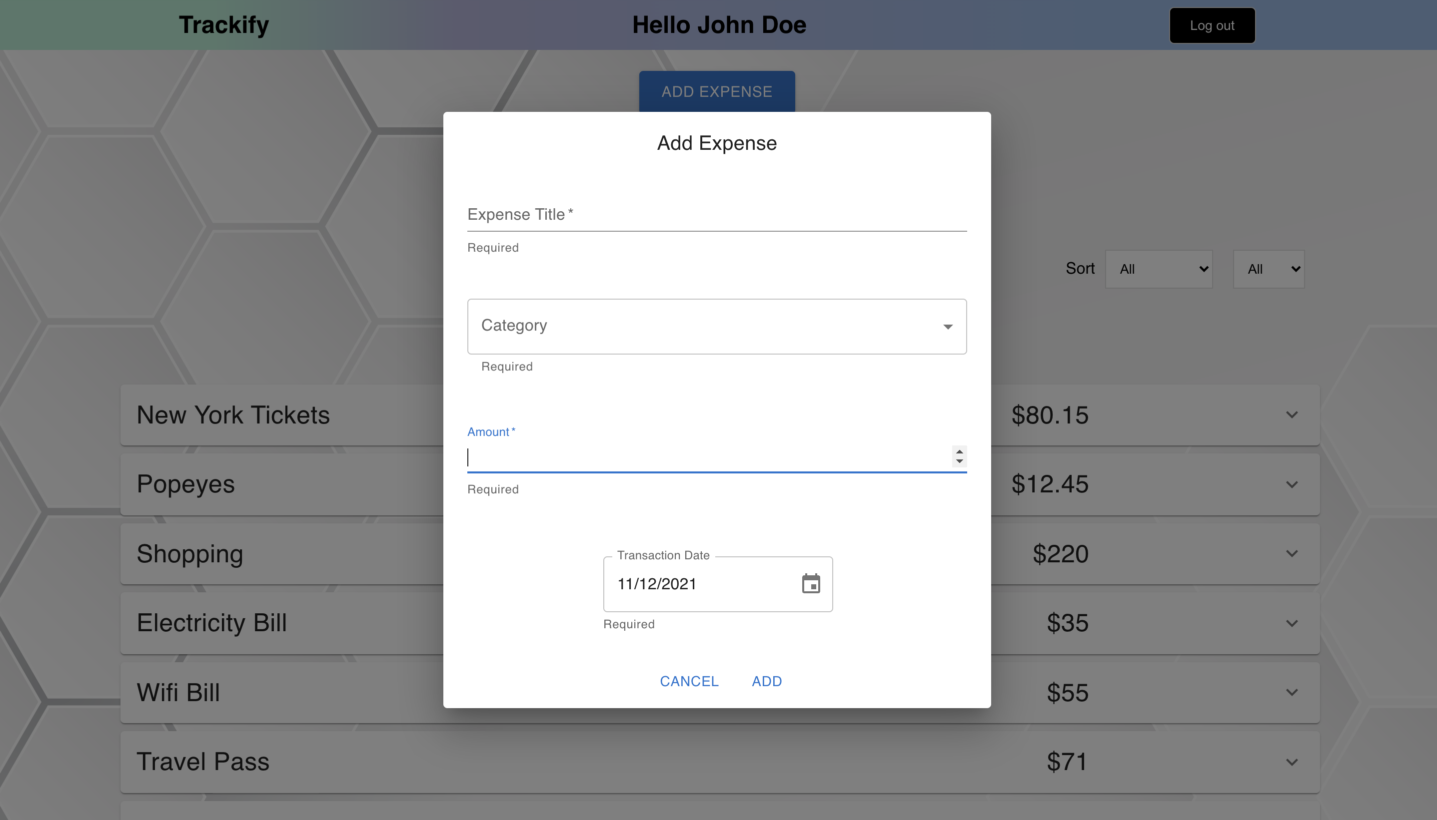

Slide 10
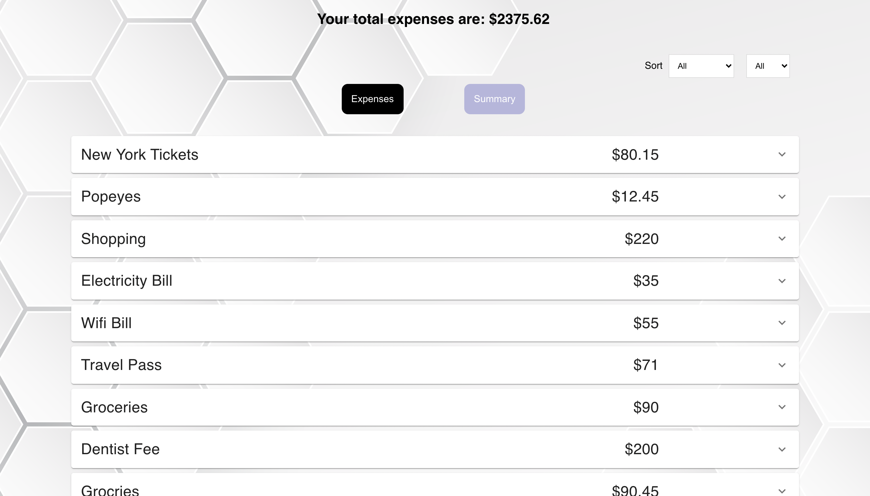

Slide 11
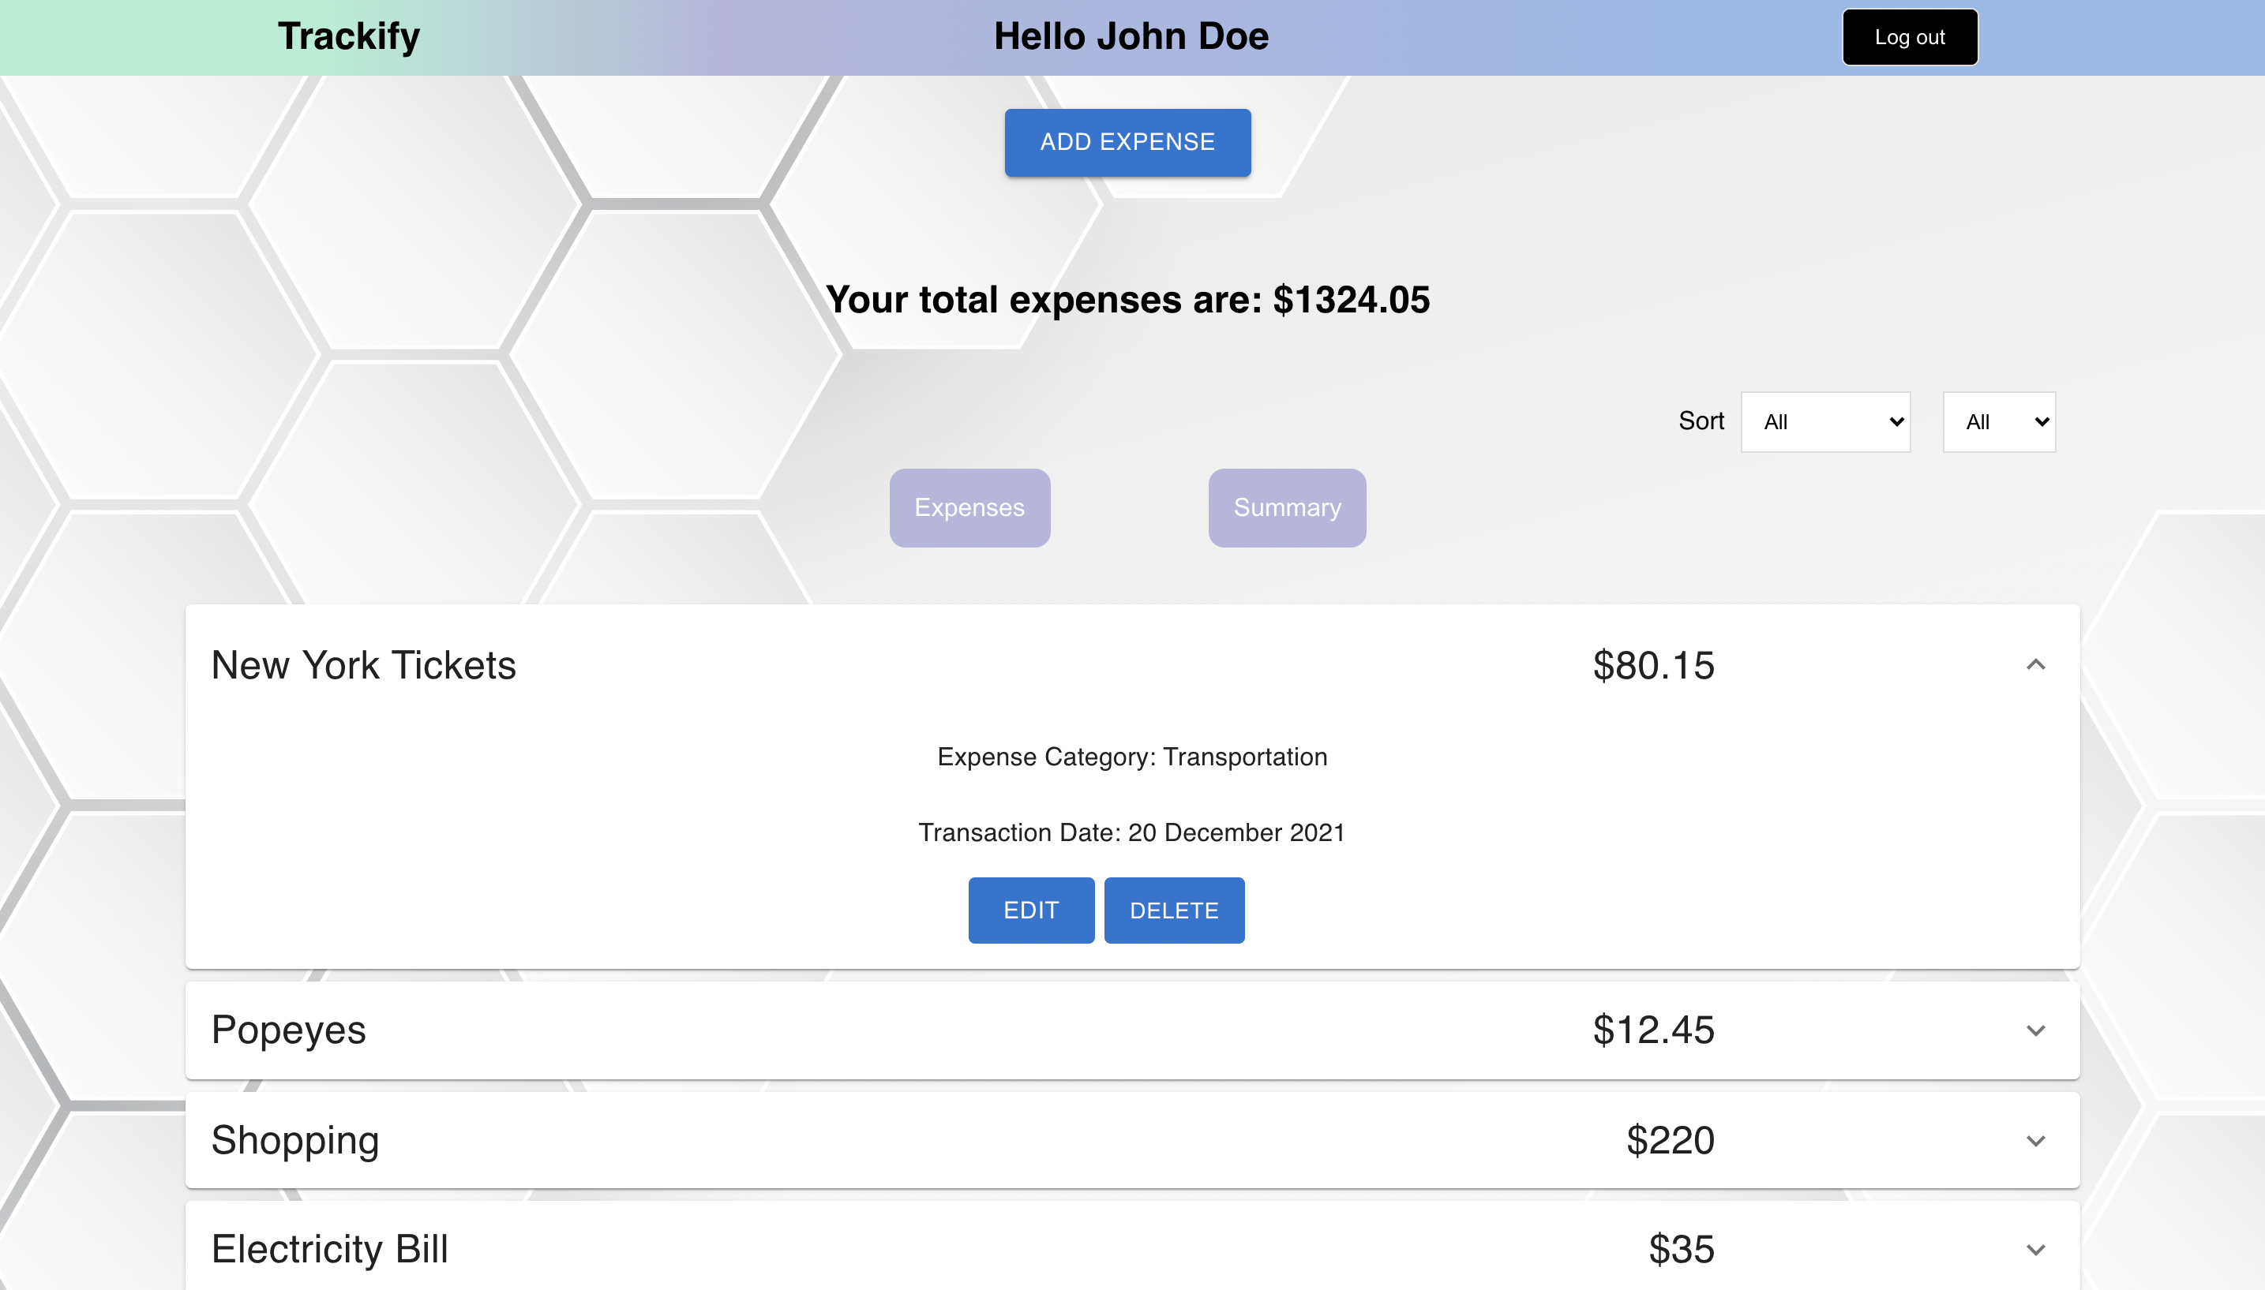

Slide 12
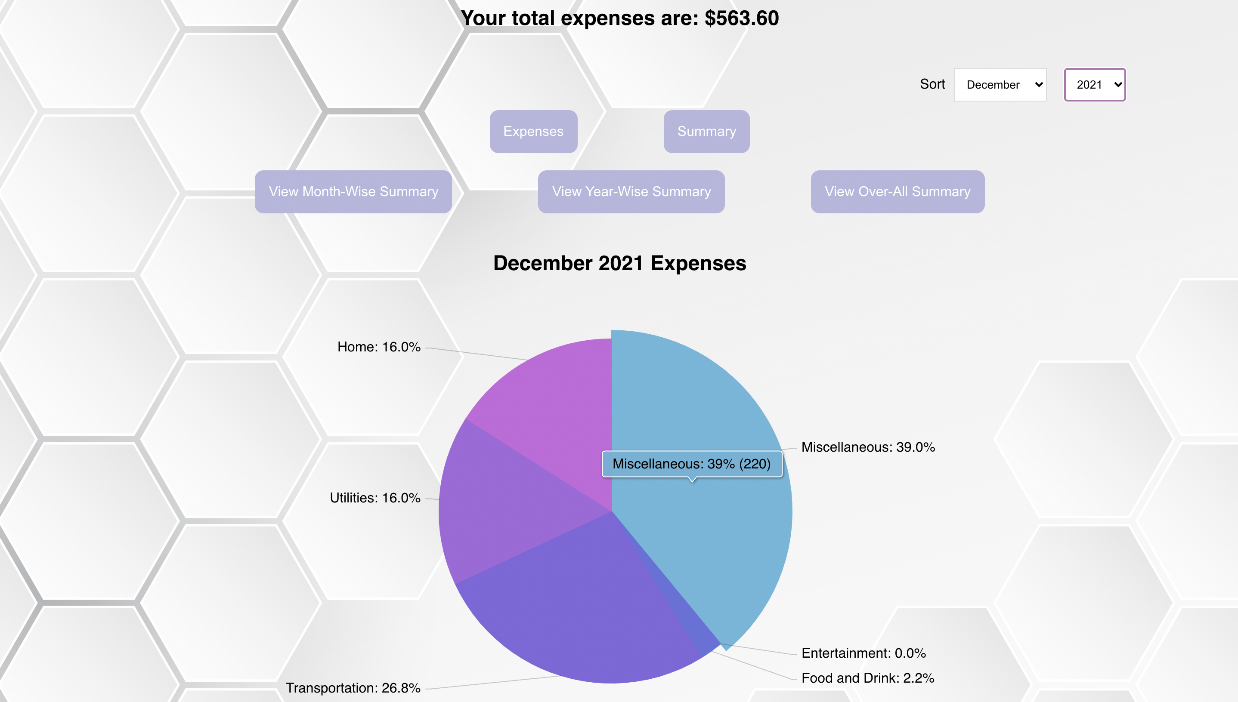

Slide 13
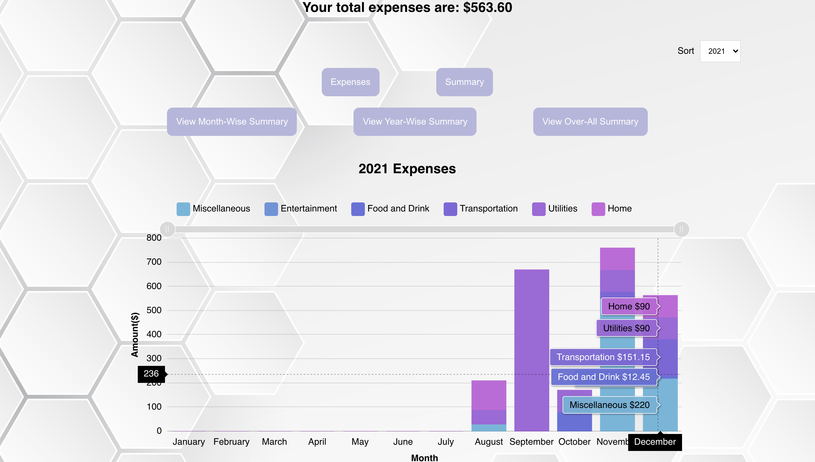

Slide 14
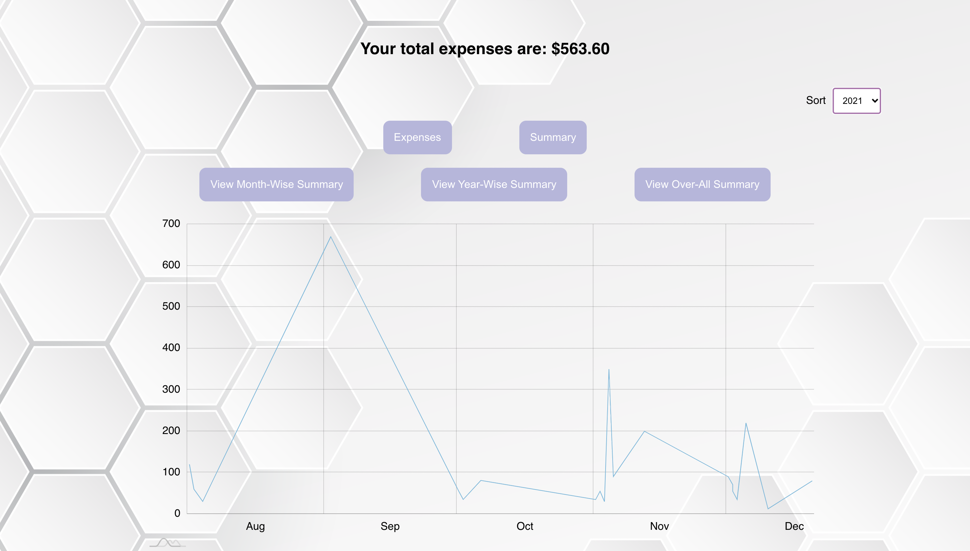

Slide 15

THANK YOU

